Slide 1
Early Detection of Alzheimer’s Disease Using Deep Learning

Slide 2
Submitted By
Mohammad Fahim Shahriar
ID: 18-37258-1
Bazlul Bari Mozharul Haq
ID: 18-37266-1
Tamzid Ahmed
ID: 18-37503-1
Md. Atiqur Rahman
ID: 18-37535-1

Slide 3
Acknowledgement
Almighty Allah for giving the strength and courage
Parents for relentless support
Dr. S. M. Hasan Mahmud Sir for his continuous support and communication
Google for freely providing services like Google Colab

Slide 4
Introduction

Slide 5
Motivation
Incurable, costly disease
Early detection can ensure better results
Clinical diagnosis is costly and often performed in mid stages
Using machine learning can be a faster and easier approach
sMRI can be used as it is non-invasive

Slide 6
Thesis Objective
Propose a Convolutional Neural Network for early detection of Alzheimer’s Disease
Comparing the model with other classifiers in terms of accuracy
Suggesting the best model for specific class detection in terms of precision and recall

Slide 7
Background

Slide 8
Alzhiemer’s Disease
Frequently forget things
Early stages are similar with normal elderly aging
Has no permanent cure at the moment
Mild Cognitive Impairment

Slide 9
Risk Factors
Age
Mostly effects elderly population
Risk doubles for every five year for people aged over 64
Sex
Data shows women are more prone to AD
Can be attributed to women generally living longer
Family History
Environmental and Herediatry factors play a role

Slide 10
Biomarkers
Amyloid beta
Loss of neuron
Calculating tau levels
Constant memory loss
Cognitive decline

Slide 11
Symptoms
Difficulty in remembering new information
Confusion about pass events
Short-time memory loss
Decline in emotional control
Erosion of even the deepest memories

Slide 12
Diagnosis
Difficult to differentiate between general aging
Often clinical diagnosis is performed in mid to late stage of AD
Difficult to pinpoint transition point between pre dementia and post dementia
Machine learning and deep learning show promise of early detection in the future

Slide 13
Structural Magnetic Resonance Imaging
Non-invasive imaging technique
Used on diagnosis related to soft tissues
Two types of signal weighting is used
T1 weighted images are better for brain scans
Images can be sliced into 3 planes.

Slide 14
Organizations
The Alzheimer’s Disease Neuroimaging Initiative
Works on rapid diagnosis of Alzheimer's Disease
Provides clinical data on Alzheimer's Disease
The Alzheimer's Association
Provides support and research resources
Review and update existing information on Alzheimer's Disease
The Laboratory of Neuro Imaging (LONI)
Develop computerized brain map
Manages ADNI data

Slide 15
Machine Learning and Deep Learning
Machine Learning
promotes computation automation
Multi disciplinary field used on various sectors
Deep Learning
Part of Machine Learning focused on multi layered neural networks
Classifiers used for this thesis: ANN,CNN Random Forest, Support Vector Machine, KNN.

Slide 16
Literature Review

Slide 17
Literature Statistics
sMRI is the most used neuroimaging technique

Slide 18
Literature Statistics (Continued)
CN vs AD is the most common classification performed

Slide 19
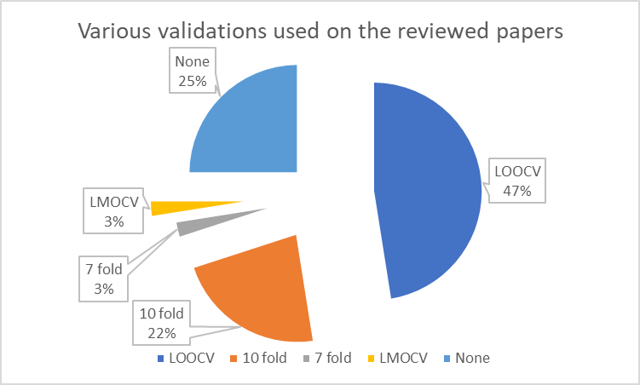
Literature Statistics (Continued)
Leave One Out Cross Validation is the most common validation used

Slide 20
Methodology

Slide 21
Dataset Description
T1-weighted sMRI image
Contains 5 classes
256x256 pixel
Sourced from Kaggle

Slide 22
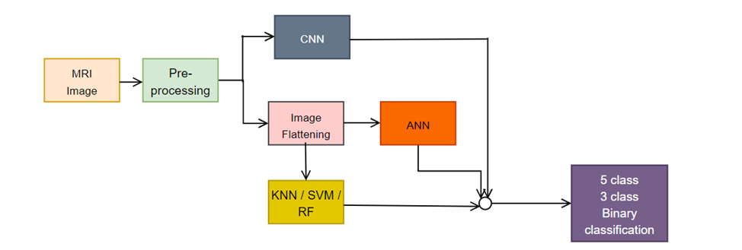
Methods

Slide 23
Data Pre-Processing
Normalization
Downscaling
Data Augmentation using Random Oversampling
Smoothening
Data Spliting

Slide 24
Tools and libraries used
Tensorflow
Scikit-learn
Keras
OpenCV

Slide 25
Model training and classification
Total 5 types of target classification
5 different classifiers are used for each classification
25 training scenarios in total
Random Forest
Imported from Scikit-learn
Hyperparameters: trees=150, tree depth=25, the rest of the values are default

Slide 26
Model training and classification
Support Vector Machine
Linear SVM imported from Scikit-learn
Hyperparameters: fit interval = TRUE, dual value = FALSE,C = 0.5, classification = one vs rest, class weight = balanced, iterations = 1600, the rest of the values are default

Slide 27
Model training and classification
KNN
imported from Scikit-learn
Hyperparameters: k = 7, distance = Manhattan ,weights = distance, leaf size = 35, the rest of the values are default

Slide 28
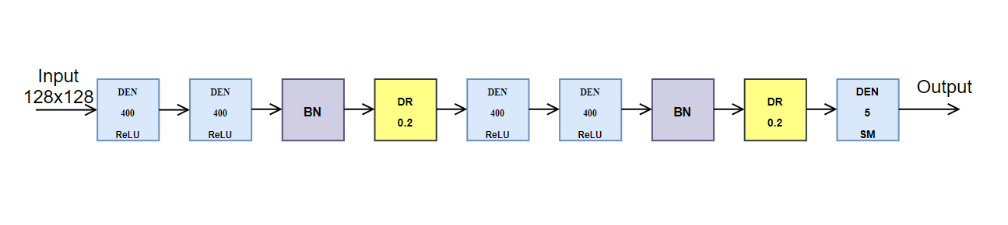
Model training and classification
ANN
TensorFlow and Keras modules used
5 dense layers , optimizer = adam, loss function = categorical cross-entropy

Slide 29
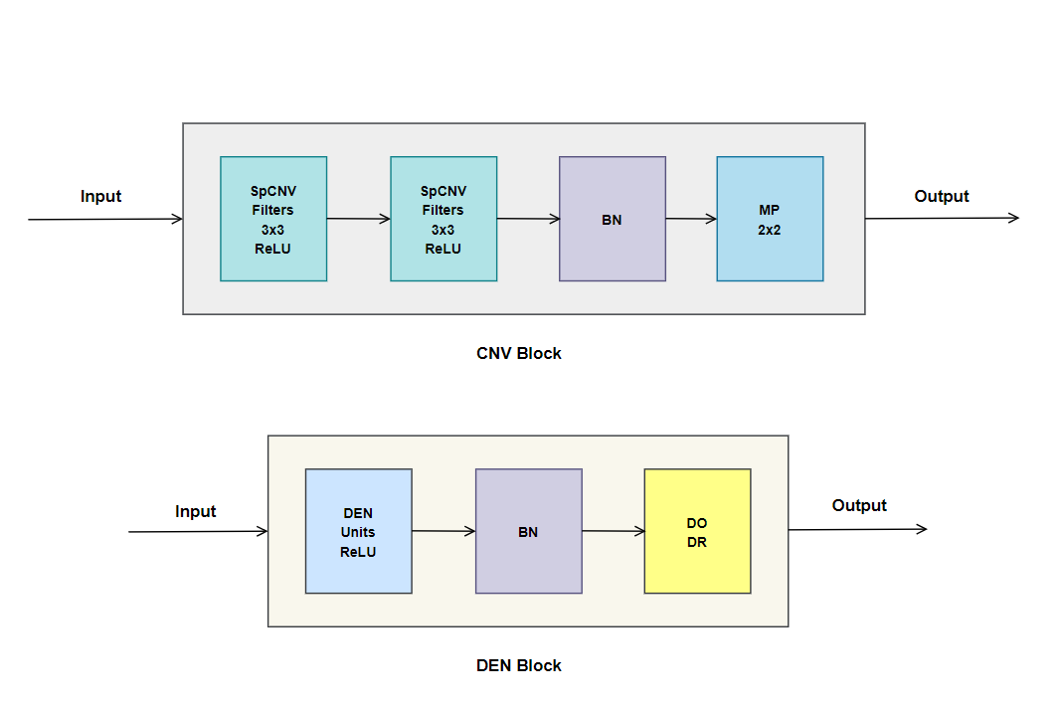
Model training and classification
CNN
TensorFlow and Keras modules used
For SpCNV, filter size = 3x3, activation = ReLU

Slide 30
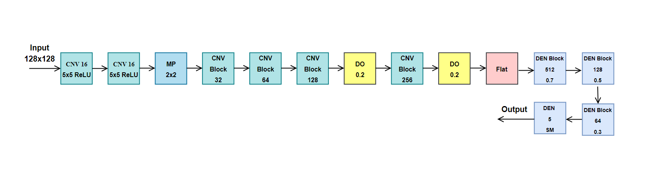
Model training and classification
CNN
For CNV, 16 kernels, kernel size = 5x5, initializer = he_uniform, activation = ReLU
optimizer = adam, loss function = categorical cross-entropy

Slide 31
Results

Slide 32
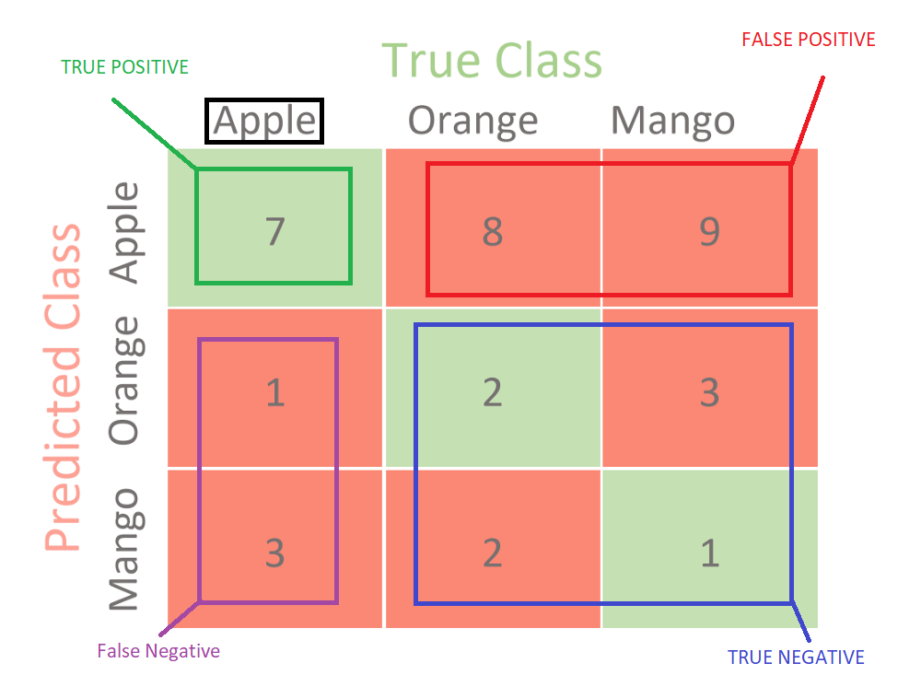
Confusion Matrix

Slide 33
Confusion Matrix
Accuracy
Precision
Recall

Slide 34
Overall Performance
Architecture | 5-class | 3-class (AD vs MCI vs CN) | CN vs AD | MCI vs AD | MCI vs CN
KNN | 0.750 | 0.742 | 0.868 | 0.745 | 0.761
CNN | 0.790 | 0.795 | 0.882 | 0.810 | 0.800
ANN | 0.633 | 0.740 | 0.823 | 0.776 | 0.761
Random Forest | 0.747 | 0.792 | 0.864 | 0.765 | 0.757
Support Vector Machine (SVM) | 0.617 | 0.667 | 0.784 | 0.686 | 0.736

Slide 35
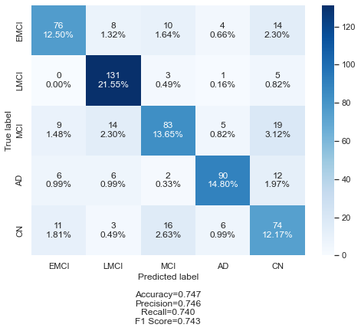
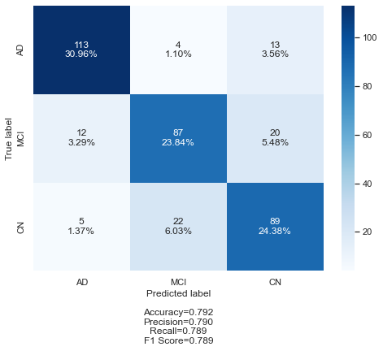
Confusion Matrices of the classifiers
Random Forest

Slide 36
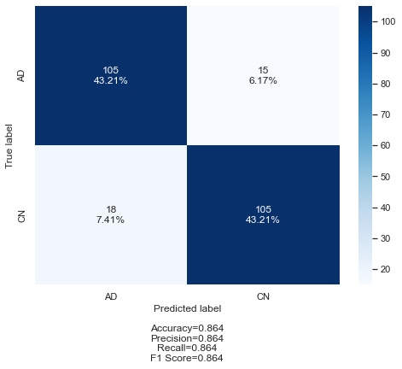
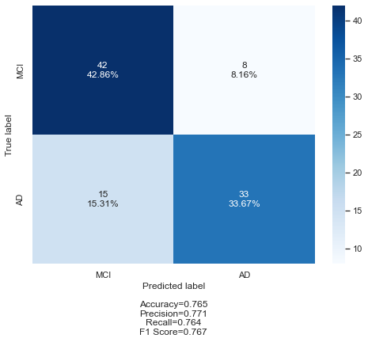

Confusion Matrices of the classifiers
Random Forest

Slide 37
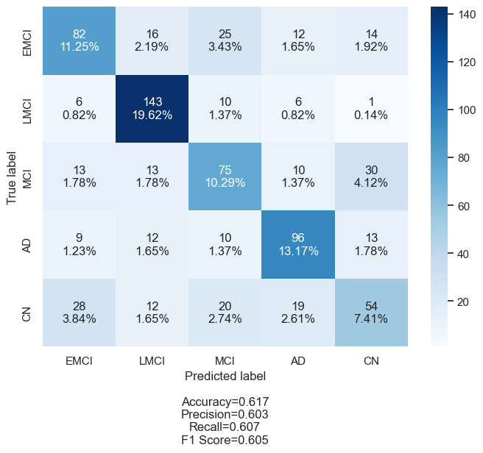
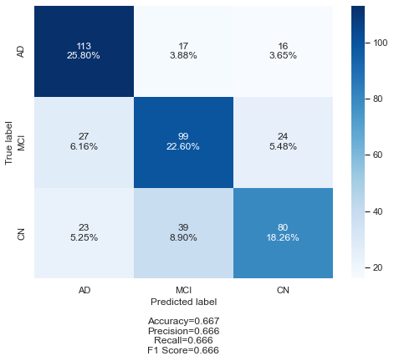
Confusion Matrices of the classifiers
Support Vector Machine

Slide 38

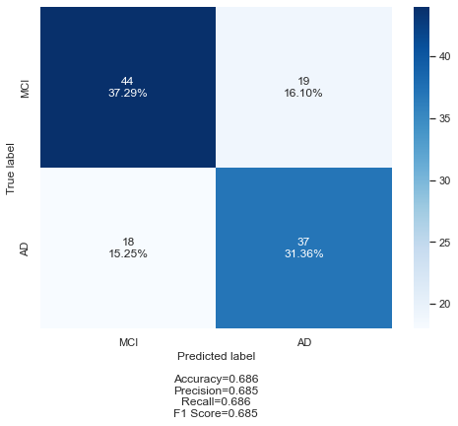
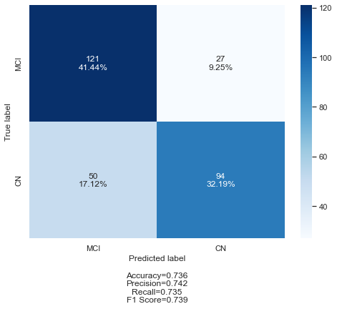
Confusion Matrices of the classifiers
Support Vector Machine

Slide 39
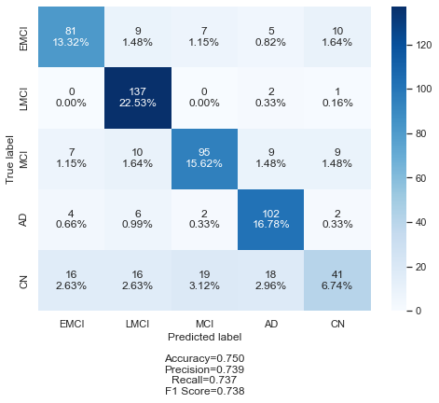
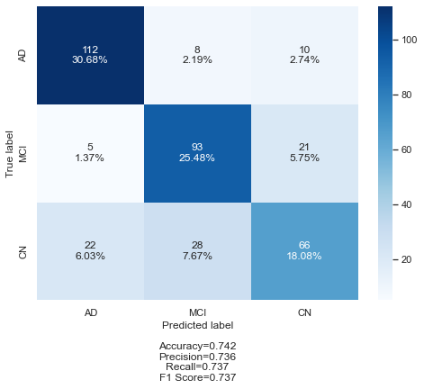
Confusion Matrices of the classifiers
KNN

Slide 40

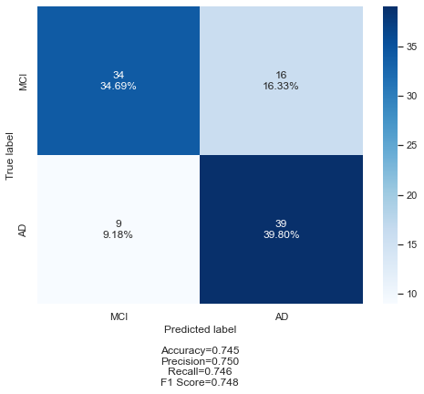

Confusion Matrices of the classifiers
KNN

Slide 41
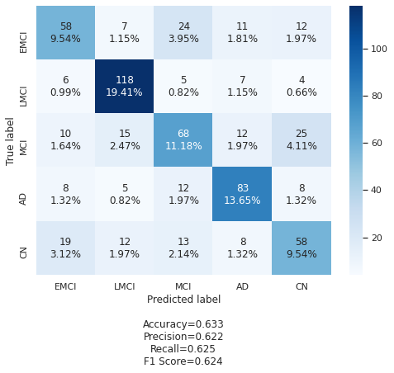
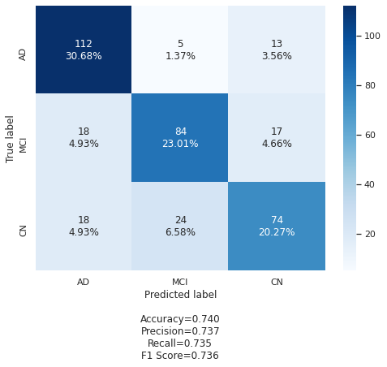
Confusion Matrices of the classifiers
ANN

Slide 42
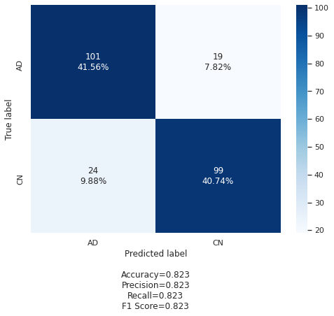
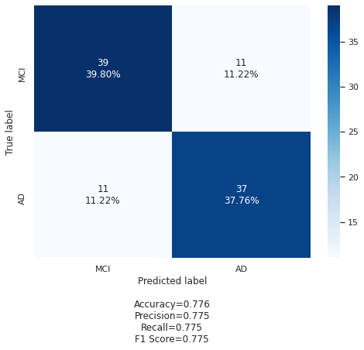
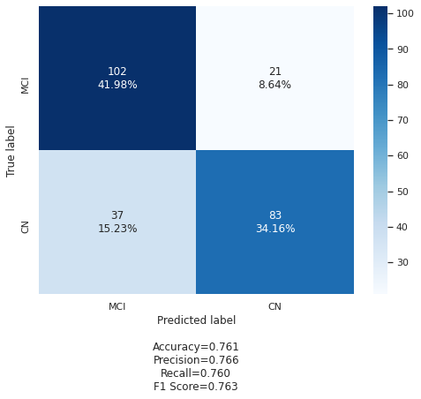
Confusion Matrices of the classifiers
ANN

Slide 43
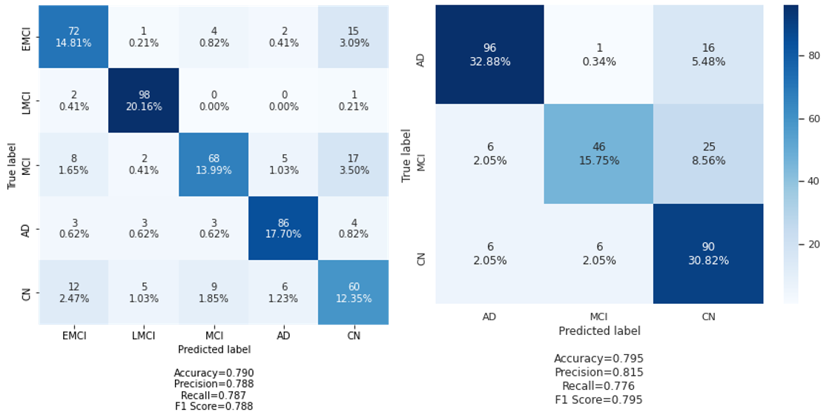
Confusion Matrices of the classifiers
CNN

Slide 44

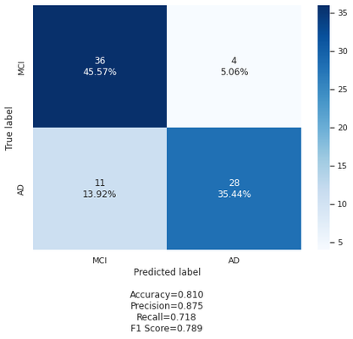
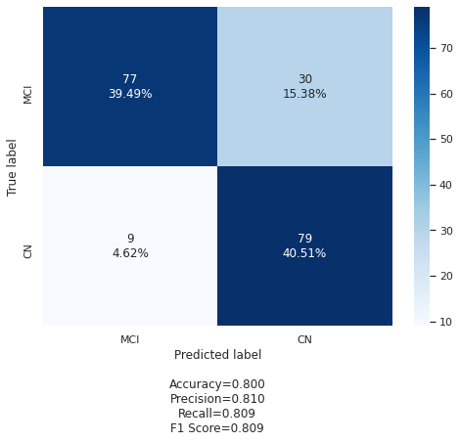
Confusion Matrices of the classifiers
CNN

Slide 45
Classification-wise Comparision (5-class)
Classifier for 5-class | Accuracy | Precision |  |  |  |  | Recall
 |  | EMCI | MCI | LMCI | AD | CN | EMCI | MCI | LMCI | AD | CN
RF | 0.747 | 0.75 | 0.73 | 0.81 | 0.85 | 0.60 | 0.68 | 0.64 | 0.94 | 0.78 | 0.67
SVM | 0.617 | 0.59 | 0.54 | 0.73 | 0.67 | 0.48 | 0.55 | 0.53 | 0.86 | 0.69 | 0.41
KNN | 0.750 | 0.75 | 0.77 | 0.77 | 0.75 | 0.65 | 0.72 | 0.73 | 0.98 | 0.88 | 0.37
ANN | 0.633 | 0.57 | 0.56 | 0.75 | 0.69 | 0.54 | 0.52 | 0.52 | 0.84 | 0.72 | 0.53
CNN | 0.790 | 0.74 | 0.81 | 0.90 | 0.87 | 0.62 | 0.77 | 0.68 | 0.97 | 0.87 | 0.65
EMCI: Highest Precision RF/KNN, Highest Recall :CNN
MCI: Highest Precision CNN, Highest Recall :KNN
LMCI: Highest Precision CNN, Highest Recall :KNN
AD: Highest Precision CNN, Highest Recall :KNN
CN: Highest Precision KNN, Highest Recall :RF

Slide 46
Classification-wise Comparision (AD vs MCI vs CN)
Classifier for AD vs MCI vs CN | Accuracy | Precision |  |  | Recall
 |  | AD | MCI | CN | AD | MCI | CN
RF | 0.792 | 0.87 | 0.77 | 0.73 | 0.87 | 0.73 | 0.77
SVM | 0.667 | 0.69 | 0.64 | 0.67 | 0.77 | 0.66 | 0.56
KNN | 0.742 | 0.81 | 0.72 | 0.68 | 0.86 | 0.78 | 0.57
ANN | 0.740 | 0.76 | 0.74 | 0.71 | 0.86 | 0.71 | 0.64
CNN | 0.795 | 0.89 | 0.87 | 0.69 | 0.85 | 0.60 | 0.88
MCI: Highest Precision CNN, Highest Recall :KNN
AD: Highest Precision CNN, Highest Recall :RF
CN: Highest Precision RF, Highest Recall :CNN

Slide 47
Classification-wise Comparision (AD vs CN)
Classifier for AD vs CN | Accuracy | Precision |  | Recall
 |  | AD | CN | AD | CN
RF | 0.864 | 0.85 | 0.88 | 0.88 | 0.85
SVM | 0.784 | 0.77 | 0.80 | 0.81 | 0.76
KNN | 0.868 | 0.80 | 0.97 | 0.97 | 0.76
ANN | 0.823 | 0.81 | 0.84 | 0.84 | 0.80
CNN | 0.882 | 0.91 | 0.86 | 0.86 | 0.90
AD: Highest Precision CNN, Highest Recall :KNN
CN: Highest Precision KNN, Highest Recall :CNN

Slide 48
Classification-wise Comparision (MCI vs AD)
Classifier for MCI vs AD | Accuracy | Precision |  | Recall
 |  | MCI | AD | MCI | AD
RF | 0.765 | 0.74 | 0.80 | 0.84 | 0.69
SVM | 0.686 | 0.71 | 0.66 | 0.70 | 0.67
KNN | 0.745 | 0.79 | 0.71 | 0.68 | 0.81
ANN | 0.776 | 0.78 | 0.77 | 0.78 | 0.77
CNN | 0.810 | 0.77 | 0.88 | 0.90 | 0.72
MCI: Highest Precision KNN, Highest Recall :CNN
AD: Highest Precision CNN, Highest Recall :KNN

Slide 49
Classification-wise Comparision (MCI vs CN)
Classifier for MCI vs CN | Accuracy | Precision |  | Recall
 |  | MCI | CN | MCI | CN
RF | 0.757 | 0.73 | 0.79 | 0.82 | 0.69
SVM | 0.736 | 0.71 | 0.78 | 0.82 | 0.65
KNN | 0.761 | 0.72 | 0.82 | 0.86 | 0.66
ANN | 0.761 | 0.73 | 0.80 | 0.83 | 0.69
CNN | 0.800 | 0.90 | 0.72 | 0.72 | 0.90
MCI: Highest Precision CNN, Highest Recall :KNN
CN: Highest Precision KNN, Highest Recall :CNN

Slide 50
Discussion and Conclusion

Slide 51
Significance of Result
Each classifier has its own strength
CNN performs best for early detection of AD
when false positive or false negative rate matters, precision and recall is considered.
In binary classifications, CNN and KNN performed best in terms of precision and recall
Random Forest performed well in certain cases

Slide 52
Significance of Result (continued)
In some cases, the accuracy values were in par with the values found in literature reviews
To authors knowledge, no work is done in 5 class classification.
Very little work is done in 3 class classification, and class wise precision and recall work is less available
In binary classifications, CNN and KNN performed best in terms of precision and recall
Further tuning, training and testing is needed to fully realize model potential.

Slide 53
Limitations
Dataset
Lack of quality 2d image dataset
Only a single dataset dealing with 5 class.
Small number of image instances
Oversampling reduces image diversity
With splitting the dataset, the model has lesser instances to train on

Slide 54
Limitations
Pre-processing
Not flexible like 3d images
Brain splitting could be performed to get better brain slices
More feature selection and extraction techniques could be used

Slide 55
Limitations
Algorithms
Using better kernel for SVM
More in-depth parameter tuning
Small training data so prone to overfitting

Slide 56
Future Work
Working on more robust dataset with 3d image instances.
Unsupervised approaches can be taken
Other frameworks of CNN such as AlexNet, VGG16, ResNet, Inception, GAN can be used.
PET and EEG data can be utilized in future iterations

Slide 57
Conclusion
Early detection is a difficult problem that is still remaining unsolvable
Different classes are very similar and thus challenging to classify as classes increase
Early stages are similar with normal aging
Very little progress is made in 4-5 class classification.
Accuracies are not strong enough to replace clinical diagnosis
When testing accuracy can reach to 97-98% for 5-7 classes, then the models can be considered for replacing clinical diagnosis.

Slide 58
Thank You

